Slide 1
Supplier Training: Product Carbon Footprint
1st June 2023
Notes:
Hello everyone, welcome to the final Corning supplier support webinar focused on product Carbon Footprint

Slide 2
Information security
This presentation contains Corning information and is intended solely for those with a need to know. It may not be distributed, in whole or part, in any form by any means, or by any person or organization without authorization from Corning Incorporated.
Notes:
This presentation contains Corning information and is intended solely for those with a need to know. It may not be distributed, in whole or part, in any form by any means, or by any person or organization without authorization from Corning Incorporated.

Slide 3
Speakers
Isaac Emery
Project Director WSP,
Sustainability Energy and Climate Change
Lakmini Senadheera
Senior Consultant WSP,
Sustainability Energy and Climate Change
Adeola Adeusi (Didi)
Project Manager,
Global Supply Management Corning Inc.
Notes:
I am Lakmini Senadheera and I am part of the sustainability energy and climate change team at WSP.
Our team at WSP is supporting Corning on their sustainable supplier engagement program
Today I will be joined by Isaac Emery, LCA and Product carbon footprint expert who is also part of the WSP team and Adeola Adeusi, Didi from Corning who is managing the Corning sustainable supplier engagement program which you may hear referred to as "Project Megaton"

Slide 4
Planned Training Webinars
Training Topic | Webinar Date
Scopes 1&2 Accounting Training | May 4th
Scope 3 Accounting Training | May 11th
Setting a Science Based Target Training | May 18th
Renewable Energy Target and Procurement Training | May 25th
Product Carbon Footprint Training | June 1st
Suppliers that are requested to attend specific trainings based on maturity level will be notified by email. All trainings are optional for all suppliers.
Notes:
We've already hosted 4 training webinars in May to help Corning's suppliers get up to speed on the basic topics that will enable you to meet Corning's new expectations
These webinars will be recorded and shared with you all for future references.

Slide 5
Agenda
Webinar Objectives
Corning Overview and Supplier Expectations
Definition Refresh
Key takeaways
What are LCA and Product Carbon Footprint (PCF)?
Product Carbon Footprint process start to finish
Reporting and communication
Applications of Product Carbon Footprint
Notes:
In today's webinar we will first provide an overview of the webinar objectives and what you should walk away from the webinar understanding
Didi will then provide a brief overview of Corning's sustainability goals and updated supplier expectations
Next I will cover an introduction to some terms we are going to used in webinar and what LCA and products carbon footprint is
Then a high level process of developing PCF and reporting and communication
Finally we will close by summarizing the application and benefits of PCF and some helpful resources you can reference after the webinar

Slide 6
Webinar Objectives
Understand Corning’s updated supplier expectations
Providing general resources and understanding of Product Carbon Footprint 101
Notes:
The goal of this webinar is to provide you information so that after the webinar you
Understand Corning's updated supplier expectations
Understand the process to develop a robust PCF

Slide 7
Corning Scope 3 Emission Program
Adeola Adeusi
Notes:
Now I will turn it over to Didi to give an overview of Corning's sustainability goals and supplier expectations

Slide 8
Our Approach
To Sustainability
At Corning, we take a long-term approach to sustainability, as we address key challenges of the moment and evolve to meet the needs of the future.
We think about our contributions in two categories. One is our footprint – how our actions directly affect others in areas such as gender pay equity and carbon emissions from our operations. The other is our handprint – what we enable others to do through our products and services, such as helping to deliver over 8 billion COVID-19 vaccine doses to date through our glass vials.
We prioritize areas where we have distinctive capabilities to create value for our shareholders and meaningful progress for society. We also emphasize areas where our stakeholders are looking for us to set an example – areas such as supporting human rights in our supply chain, advancing gender equity, and acting with integrity in all we do. Investing in these areas also makes us more resilient and supports our ability to do what we do best – innovate.
“Quite simply, we’ve succeeded over the long term by always working to become better versions of ourselves. We never lose sight of our purpose, our Values, and the importance of engaging with – and delivering for – key stakeholders. And that’s “our why” – we always seek to advance and apply our leadership capabilities to make a positive difference in the world.”
Wendell P. Weeks
Chairman and Chief Executive Officer

Slide 9
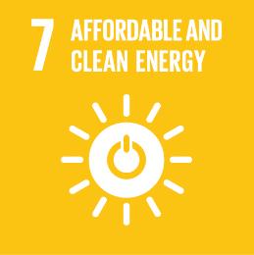
2023 Corning Sustainability Goals
Reduce our absolute Scope 1 and 2 greenhouse gas (GHG) emissions 30% by 2028 from a 2021 base year
Reduce our absolute Scope 3 GHG emissions, covering purchased goods and services, capital goods, fuel- and energy-related activities, and upstream transportation and distribution 17.5% by 2028 from a 2021 base year
Increase our use of renewable energy by 400% by 2030 from a 2018 baseline
By the end of 2023, assess Corning’s exposure to water stress
By the end of 2024, Corning will be generating monthly, accurate, and comprehensive water use data for our top 10 water-use facilities
By the end of 2028, Corning will increase its waste diversion rate to greater than 80% globally
New!
By the end of 2023, Corning will be generating monthly, accurate, and comprehensive landfill waste and diverted waste data for our top 10 waste-generating sites
Certify 100% of our high-risk suppliers as socially responsible by 2025
Reduce our total recordable case incident rate (TRIR) within the portion of our operations that disproportionately contribute to our overall recordable injury and illness rate by at least 10%
Encourage increased volunteerism efforts year over year by supporting, rewarding, and recognizing employees’ efforts in the community
Achieve understanding of the Corning Code of Conduct, including how to report allegations of ethical or legal misconduct, among 100% of employees
New!
New!
New!
New!
Notes:
We have set goals within these focus areas and we are working diligently to achieve them. These goals were developed to support the united nations sustainable development goals aligning Corning’s efforts with global action on sustainability.
Didi will talk about our greenhouse gas reduction goals. We also introduced new water, waste and safety goals.
One that is very relevant to this group is our waste goals!
The following goals were graduated:
Maintain a diverse Board of Directors Corporate Governance and Risk Management
Conduct an annual review of the Sustainability Program by the Board of Directors Corporate Responsibility and Sustainability Committee Corporate Governance and Risk Management
Address environmental, social and governance issues in our Enterprise Risk Management Process Corporate Governance and Risk Management
Issue a sustainability report in 2021 and every year thereafter Transparency and Reporting
Continue advocacy for environmental and social issues Environmental and Social Advocacy SDG 12

Slide 10
Greenhouse Gas (GHG) Emissions Reduction Goals
In 2022, Corning submitted targets for validation to the Science Based Targets initiative (SBTi), underscoring our commitment to set near-term company-wide emission reductions in line with Climate science, and aligning with the goals of the Paris Agreement.

Slide 11
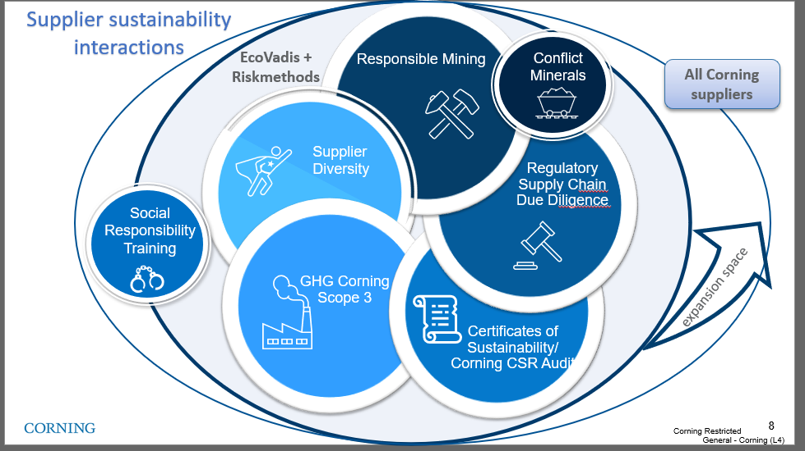
Climate Change is part of GSM's sustainability strategy
Our management of
Sustainable Supply Chain
Working with our suppliers globally, with a focus on Corporate Social Responsibility (CSR) and Climate Change Issues reduces our supply disruption risk and exposure to regulatory and reputational risk.
Our aim is to establish standardized, verified information-based management process contributing to Corning's long-term commitment on sustainable supply.
Supply Chain Sustainability Strategy
Scope 3 program
Last update Jan 2023
Notes:
CO₂ – Carbon dioxide
CH₄ – Methane
N₂O – Nitrous oxide (laughing gas)
HFC_{s} – Hydrofluorocarbons (refrigeration units, fire extinguishers, aerosols….)
PFC_{s} – Perfluorochemicals (heat, oil, water, etc., resistant coatings – think cookware, carpet stain prevention for regular people lives) mess up the endocrine activity, reduce immune function etc..
SF₆ – Sulfur hexafluoride – circuit breakers, arc suppressant , electrical insulator, semiconductor manufacturing, and the production of magnesium. One of the more potent GHG’s – it only takes a small amount to do significant damage. Used in the manufacturing as well as maintenance of grid equipment. One mitigation tactic is to regularly check equipment quality for leaks , training on employees how to maintain and service WHILE new options are being discovered.

Slide 12
2023 supplier engagement goals defined and set for deployment
Program
Deployment
Active Engagement
Emission Reduction Plan
Communicate supplier
engagement program to the suppliers that contribute 80% of Corning/Hemlock scope 3 emissions.
(PG&S, Capital Goods, Transportation)
Actively engage and train the suppliers that contribute 60% of emissions in PG&S,CAP category and 80% in the Transportation
Corning approved channel
CDP supply chain program
Develop and implement emission reduction plans with supplier classified as engaged leaders in the scope emissions program

Slide 13
2023 Supplier Activities for Scope 3 Emission
1
1
Register/ Sign up for CDP
If you company did not disclosure through CDP in 2022, please register your account.
2
Attend Trainings
2
GHG emission topics hosted by Corning/WSP
3
Calculate Emission data
3
Disclose scope 1, 2 and 3 greenhouse gas (GHG) emissions data. Provide independent or third-party assurance of disclosed emissions
4
Submit data and Allocate emission
4
Submit data through CDP. Deadline July 26th
5
Reduce Emissions
Adopt a science-based (SBTi-approved) emissions reduction target
Set a renewable energy target and water management goal
5

Slide 14
Partnership is Critical
Collaboration with suppliers will be key to enabling Corning to achieve our Scope 3 emissions reduction goal.
Working with Suppliers to Reduce Upstream Emissions
Together with our partners, Corning will continue to reduce global GHG emissions aligned with our commitment to climate action.
Corning will be rolling out our formal supplier engagement program in 2023 to reduce upstream emissions from suppliers systematically
Corning’s new product innovations are increasingly focused on reducing embodied carbon in our products and our customers’ products and operations.
Integrating Sustainability into Our Innovation Process
Corning has begun to use life cycle assessments performed by third parties to provide industry-recognized calculations of embodied carbon and we will request additional LCA information from suppliers through our supplier engagement program.
We are also developing GHG-impact estimates to be used in the early-stage design of products.

Slide 15
Corning Scope 3 Supplier Expectations
Suppliers engaged starting in 2023 are expected to adhere to these requirements by 2026:
Disclose scope 1, 2 and 3 greenhouse gas (GHG) emissions data through CDP Supply Chain
Provide independent or third-party assurance of disclosed emissions
Adopt a science-based (SBTi-approved) emissions reduction target
Set a renewable energy target
Respond to CDP Water Questionnaire
Set a water management goal

Slide 16
What are Life Cycle Assessment and Product Carbon Footprint?
Isaac Emery

Slide 17
Have you done or heard about Product Carbon Footprint or LCA before?

Slide 18
Definitions Refresh
Greenhouse Gases-Greenhouse gases (GHGs) are gases that contribute to global warming and climate change. GHGs include carbon dioxide (CO₂), methane (CH₄), nitrous oxide (N₂O), and other chemicals, including some refrigerants and manufacturing aids.
Global Warming Potential - Global warming potential (GWP) is a metric for the heat absorbed by GHGs, compared to the heat that would be absorbed by the same mass of carbon dioxide. Because different gases reflect heat differently, GWP is used to aggregate the impacts of many different GHGs into one number.
Life Cycle Assessment: Life cycle assessment (LCA) is a method for evaluating the magnitude and significance of the potential environmental impacts of a product, including its whole supply chain from extraction of raw materials to recycling or disposal (ISO 14040:2006).
Product Carbon Footprints: Product carbon footprint (PCF) is an established method for determining the climate impact of a product across its entire life cycle, based on international standards for LCA (ISO 14067: 2018).

Slide 19
What is LCA?
Life Cycle Assessment (LCA) is the investigation and valuation of the environmental impacts of a product or service
ISO-compliant life cycle assessment is the most reliable method to verify environmental impacts and support claims
LCA allows designers, regulators and engineers to explore the environmental impacts of decisions at each life stage of materials, buildings, services and infrastructure
LCA is an iterative process
LCA does not tell you what is better or best, it tells you what is
Governed by ISO Standards 14040 and 14044
Goal & Scope
Interpretation
Life Cycle Inventory (LCI)
Life Cycle Impact Assessment (LCIA)

Slide 20
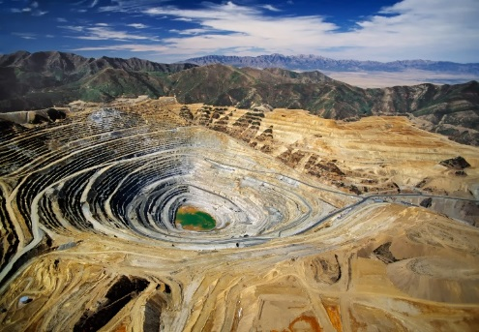
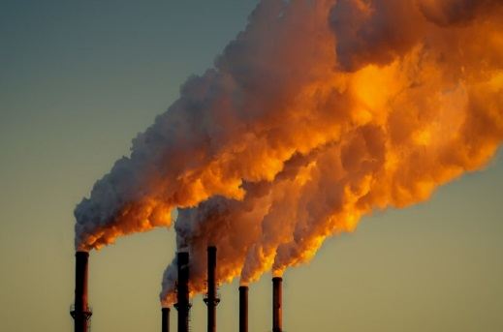
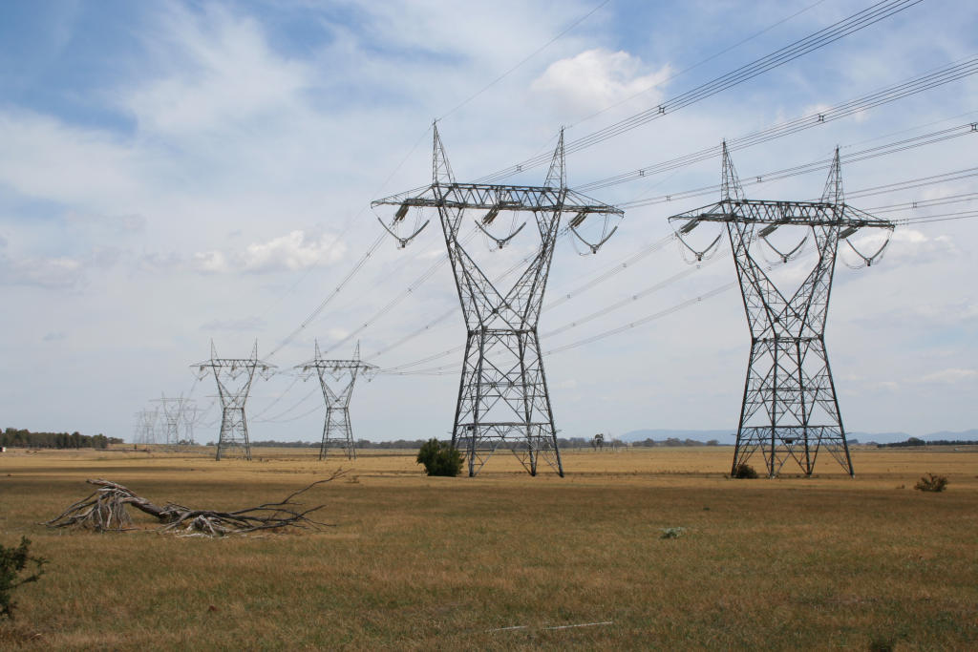
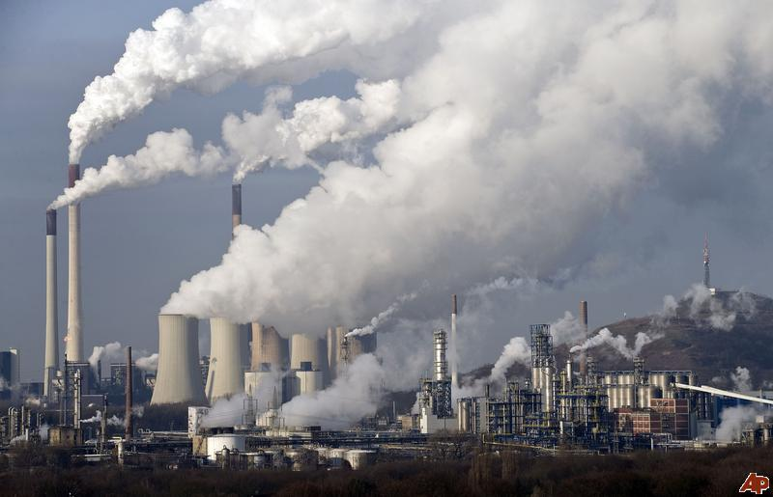
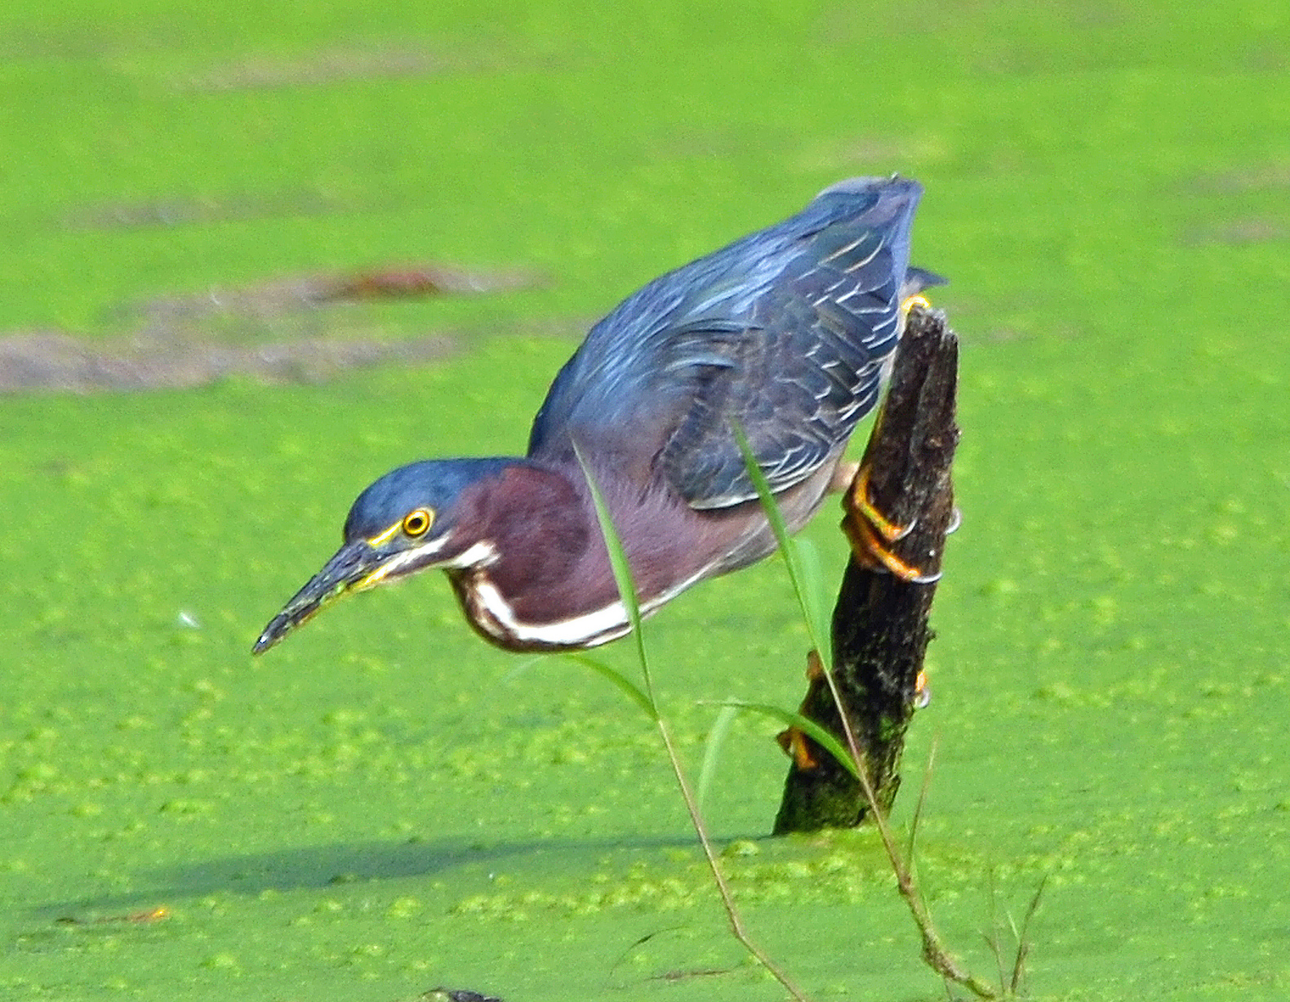
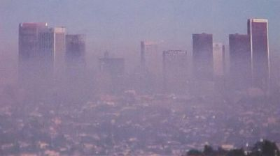
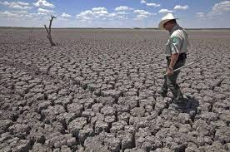
What is Life Cycle Assessment (LCA)?
Raw Materials Extraction
Materials Manufacturing
Product Manufacturing
Transport & Distribution
Product Use
Recycling
Disposal
Life Cycle Assessment
Resources
Emissions
Impacts
Energy Demand
Global Warming
Ozone Depletion
Acidification
Eutrophication
Smog Formation
Toxicity
Water Use
Water Scarcity
Notes:
LCA Background:
Life cycle assessment or LCA is a methodology for assessing environmental impacts associated with all the stages of the life cycle of a commercial product, process, or service
Life Cycle Assessment (LCA) is the investigation and valuation of the environmental impacts of a product or service
LCA does not tell you what is better or best, it tells you what is
It is an iterative process
ISO-conformant life cycle assessment is the most reliable method to verify environmental impacts and support claims.
According to the most recognized method RECIPE there are 18 impact categories. But it is important to identify what impact categories are more material to you.
There are several methodologies that determine the impact categories
CML2001-CML: CML’s impact assessment methods and characterization factors. Leiden University, Institute of Environmental Science (CML), 2001.
TRACI 2.1-Traci, Tool for Reduction and Assessment of Chemical and other environmental Impacts 2.1 (Traci), U.S. Environmental Protection Agency, 2012; Online: http://www.epa.gov/nrmrl/std/sab/traci/.
RECIPE 2016 - Huijbregts M. A. J. et al 2016. ReCiPe 2016. A harmonized life cycle impact assessment method at midpoint and endpoint level Report I: Characterization. RIVM Report 2016-0104. National Institute for Public Health and the Environment, the Netherlands
EcoIndicator99-Eco-indicator 99: A damage oriented method for Life Cycle Impact Assessment Methodology Report nr. 199/36 A, PRé Consultants B.V., Amersfoort, The Netherlands, 2000
Impact 2002+ -Impact 2002+ : École Polytechnique Fédérale de Lausanne, Lausanne, 2002.
ILCD 2010-International Reference Life Cycle Data System (ILCD) Handbook – General guide for Life Cycle Assessment – Detailed Guidance, European Union, 2010.

Slide 21
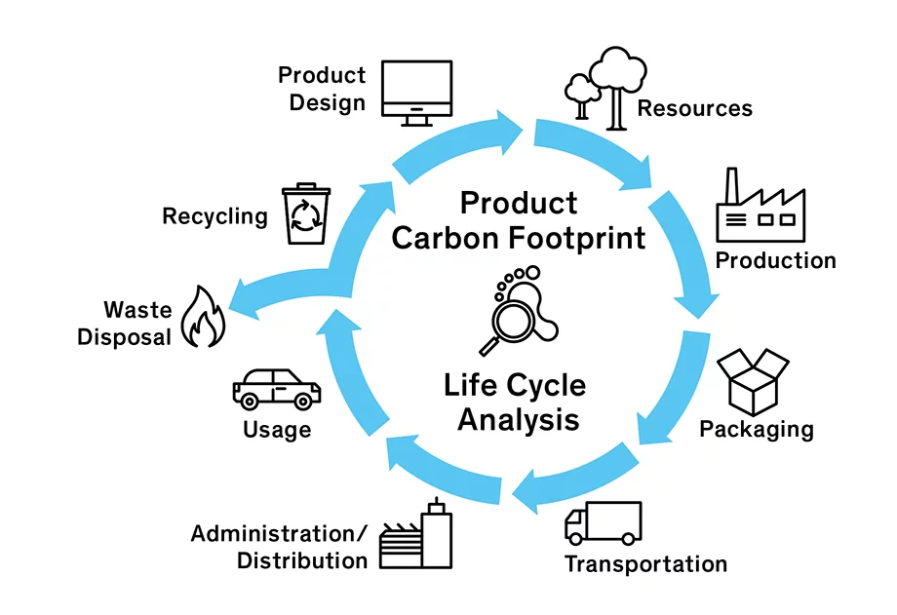
Product Carbon Footprint (PCF) is one impact category of the Life Cycle Assessment
Product Carbon Footprint (PCF) can be broadly defined as the total greenhouse gas (GHG) emissions, or CO₂-equivalent emissions (CO₂e), generated during the life cycle of a product.

Slide 22
Benefits of Product Carbon Footprint
Obtain more accurate and detailed carbon footprints of your product systems
Identify emission hot spots
Identify methods to reduce carbon impacts
Helps with product differentiation and material level improvements (e.g.) switching to low carbon materials)
Enable comparisons between products fulfilling the same function
Use supplier-specific, product-related carbon impacts to quantify accurate impacts
Calculate more accurate embodied carbon and scope 3 emissions
Develop more detailed plans for scope 3 emissions reduction

Slide 23
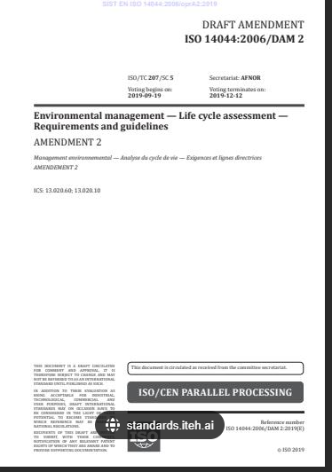
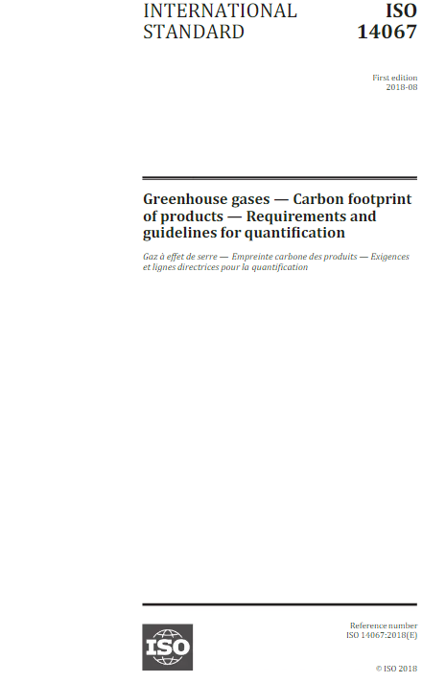
Product Carbon Footprint calculation methods
Standard | Description
ISO 14067:2018 Greenhouse gases — Carbon footprint of products — Requirements and guidelines for quantification | This is the foundation and the bases of the other product carbon footprint related guidelines or the protocols
BSI (2011) PAS 2050 – Specification for the assessment of the life cycle greenhouse gas emissions of goods and Services | Preferred by some British and European stakeholders PAS 2050 builds on ISO standards for LCA and PCF
WBCSD and WRI (2011) GHG protocol: Product Life Cycle Accounting and Reporting Standard | In 2008, WRI and WBCSD launched the three-year process to develop the Product Standard which also in-line with ISO standards This was mainly helps to understand the alignment of the GHG protocol Corporate standard and the GHG Inventories
Notes:
Speaker notes:
You can pick one standard
When do you need to know about ISO/GHG Product stds
Corning has done some LCA using ISO 14040-14044

Slide 24
How do I do a Product Carbon Footprint?
Select a Product
Conduct PCF
Create PCF report
Critical review
Data Collection
Manufacturer / Supplier
Technical Sustainability Consultant
3rd-Party Reviewer
Notes:
Presenter- Lakmini
Now let’s dive into the process of developing an EPD.
This graphic shows very high-level steps, and we will go into the details later. I want to highlight the key steps and the key stakeholders involved in the process.
You are not alone in the process; you will be interacting with multiple people when developing an EPD. There is a program operator who will be helping you to identify a PCR and register the EDP and technical consultants can help you in the data collection, calculation, and reporting and assist you with the verification process.
Once verifiers approve your EPD, it will be registered under a selected program operator.
Next, will go over the process in detail and then answer any questions you have.
So, I am going to hand over the floor to Isaac who will be explaining what is an LCA, which is the basis of an EPD. Over to you Isaac.

Slide 25
Key Steps in Quantifying Product Carbon Footprint
Built process map of product's life cycle
Establish the functional unit to be assessed
Build up life cycle process map, including material acquisition, manufacturing, transportation, use and final disposal, and waste treatment
Assess boundary and materiality
Cradle to gate or cradle to grave
Perform high level analysis ; prioritization of large emission sources, system boundary exclusions
Collect data
Collect activity data of each stage of the product life cycle
Collect/ search for the relevant emission factors
Data quality checking
Calculate the footprint
Allocation
Calculation
Sensitivity analysis/ uncertainty analysis
Reporting and communication
Reporting must be unbiased, comprehensive, and accurate
Self-verification, second-party verification or third-party critical review
Five steps to calculating product carbon footprint
Notes:
Add reporting and communication

Slide 26
Functional Unit
Definition | Quantified performance of a product system for use as a reference unit
Function | What is the function of the product? How can that be quantified?
Measurement | What units can be used to measure the function? E.g., length, mass, energy
Time | What are the temporal boundaries? E.g., Product manufacturing in a year, daily use of a product, transactions per second

Slide 27
Can you guess the Functional Unit of a toaster,
“toast two slices of bread twice a day for 5 years”
Notes:
Easy examples.

Slide 28
System Boundary
System Boundary
Cradle-to-Grave
Cradle-to-Gate
Raw Materials
Materials Manufacture
Gate-to-Gate
Product Manufacture
28
Final Disposal
Use
Transportation
& Distribution
Recycling
System boundary​
set of criteria specifying which unit processes are part of a product system
What do I need to include in my product carbon footprint?

Slide 29
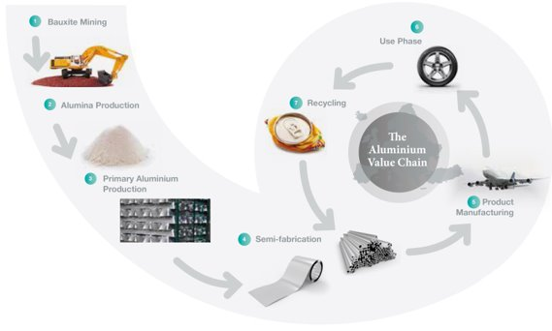
Material Flow diagram
Raw Material extraction
Upstream Transportation
Product Manufacturing
Downstream Transportation
Use Phase
Disposal
Illustrative Purposes only
Notes:
Add distribution
Check Al or steel manufacturing example- minerals

Slide 30
Where do we get the data at each stage?
Primary Data
Physical data directly attributable to the specific product being investigated​
Sourced from the commissioner of the study​
Inputs (e.g., electricity, fuel, paper)​
Outputs (e.g., products, emissions, wastes)​
Product manufacturing processes, conversion efficiencies, waste generation​
Transportation and distribution​
Secondary Data
Are proxies and assumptions, based on industry average data
Life cycle inventory data from reputable sources (e.g., literature, process documents, national labs)
Upstream and downstream of the primary process (e.g., power grid mixes, materials production, wastewater treatment)
Public databases (e.g., ecoinvent, GaBi)
Patents, technical chemist descriptions of productions
Primary Data
Secondary Data
Secondary Data
Raw Material extraction
Upstream Transportation
Product Manufacturing
Downstream Transportation
Use Phase
Disposal
Product Carbon Model
Notes:
Temporal coverage, geographical specificity, technology coverage, accuracy, precision, completeness, consistency, reproducibility and data sources

Slide 31
What do we get the data at each stage?
Primary Data
Secondary Data
Secondary Data
Raw Material extraction
Upstream Transportation
Product Manufacturing
Downstream Transportation
Use Phase
Disposal
Energy use in the raw material extraction
Embodied carbon of the raw material process
Transportation distances
Fuel consumption during manufacturing
Electricity consumption
Waste generated during manufacturing
Energy use in the use phase
Waste disposal method
Product Carbon Model
Notes:
Temporal coverage, geographical specificity, technology coverage, accuracy, precision, completeness, consistency, reproducibility and data sources

Slide 32
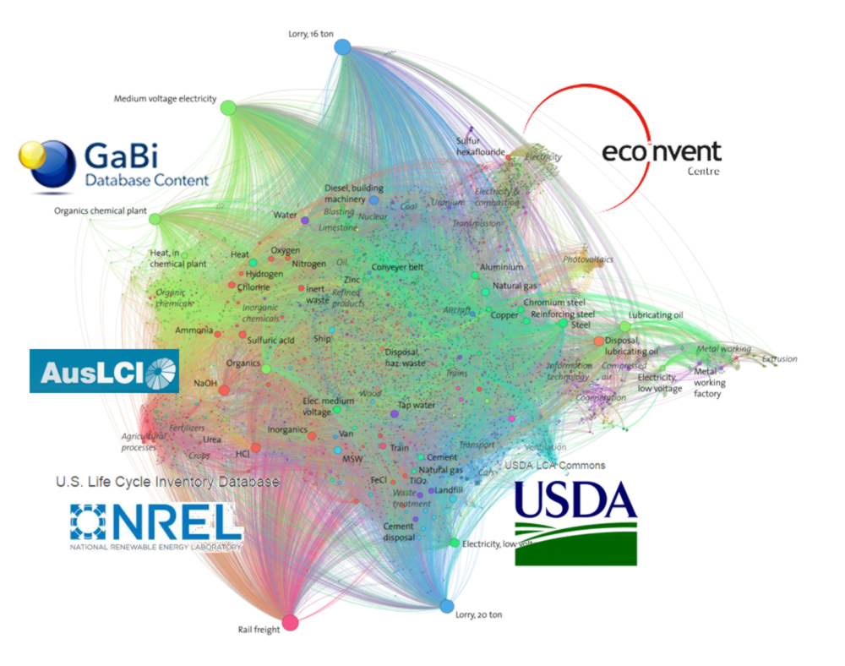
Emission Factor Databases
LCA/ PCF experts use databases to fill data gaps and model other parts of the life cycle using available databases.
LCI databases can be available as international, regional, or national collections of datasets
Following are some of the databases available:
Gabi Databases
GaBi Databases provide a reliable basis for strategic decision-making in the fast-changing business environment owned by Sphera Solutions GmbH
ecoinvent Database
Association in Switzerland offers a background database for life cycle assessment
U.S. Life Cycle Inventory (USLCI)
Database created by NREL
Australian Life Cycle Inventory (AusLCI)
European Life-Cycle Database (ELCD)
Carbon Minds
Detailed materials LCA and chemical supplier carbon footprint data for some industries
Notes:
Speaker notes: Lakmini
Once we collect primary and secondary data, LCA or PPCF experts fill the gaps and model other missing part of the life cycle using available databases.

Slide 33
LCA/ PCF Software
Modeling tools that use life cycle inventory data sets to calculate environmental impacts
Umberto NX T CO2
Umberto is developed by interdisciplinary team from ifu Hamburg GmbH, the Institute for Environmental Information Technology
SimaPro
SimaPro has been established for more than 30 years and is probably the most well-known LCA Tool in the market. SimaPro is used primarily in the academic field and by experienced LCA consultants.
LCA for Experts (GaBi)
LCA for Experts, formally known as GaBi has been established since the mid 90’s. It is also a very established LCA tool, being used in many industries, especially in its home market, Germany. GaBi is used especially by consultants but also in-house.
openLCA
openLCA is an open-source LCA solution, which means that it is attractive for anyone starting off in the LCA world without a big budget.
Notes:
These are some of the software available in the market that helps to build the models and the link all the input activity data the emission factors/ conversion factors. Most of these software have embedded databases with emission conversion factors using realizable research studies to convert the activity data to GHG emissions.
There are other online tools available such as Mobius, and OneClickLCA But those are with limited access to the databased. Only freely available emission factors.

Slide 34
Interpretation
PCF results can show which life cycle phase is the source of the most significant environmental impacts
Hot Spot Analysis
Use phase is a hot spot in Global Warming Potential (GWP)
Raw material extraction and manufacturing are second and third highest emissions and thus important for decision making
Reducing GWP in the use phase might have unintended consequences on other impacts
Illustrative purpose only
Notes:
Once we model all the processes and input data, we can get the PCF results as shown in this diagram
Can you guess a product that can have an emission distribution like this- a high energy consuming machine…. Or t-shirt which can be used for years- uses a lot of washing and drying..
But if you are a raw material supplier, most probably you might have high emissions in the raw material extraction stage… or during the manufacturing of the material..
It helps to identify the emission hots spots or during what process of the products lifecycle will have the most significant emission impact
And Tells you what or where you have to focus if you want to reduce your impact

Slide 35
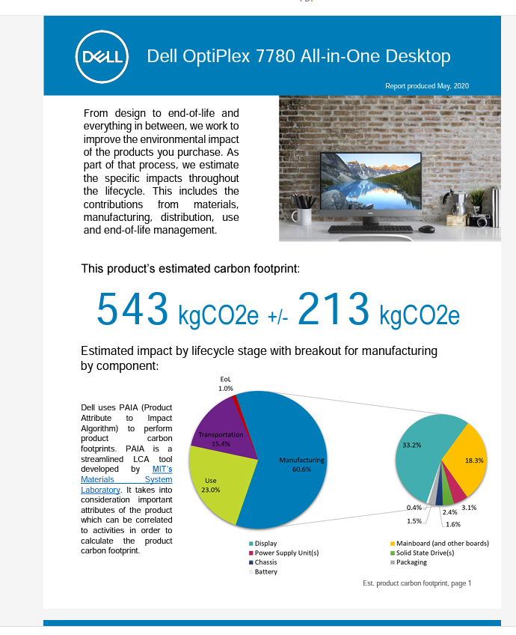
Product Carbon Footprint Report
Report must summarize
Data sources
Process descriptions
Life Cycle Inventory (LCI) and Calculation
Assumptions & limitations
Data quality assessment
Conclusions & recommendations
Goal & scope
Any sensitivity analysis or uncertainty analysis conducted
Third-Party Verification
Notes:
and finally once you have the results, you can develop the PCF report. The rep[ort mainly should consist of the following items.
Check ISO 14067 on the reporting and the requirements

Slide 36
External Verification/ Critical Review
External Disclosure?
Substantiate comparative external marketing claims?
Yes
3-person critical review panel
No
3rd party critical review not required
Yes
No
1-person critical review
Third-party critical review:
mitigates risk associated with making public statements about the comparative impacts of products
is best practice for studies that will support external marketing claims
is required by ISO standards if the results of a study are to be made public and considered ISO-conformant third-party
Notes:
External verification is important just like how you do with the corporate GHG inventory.
It mitigates risk associated with making public statements about the comparative impacts of products
is best practice for studies that will support external marketing claims
is required by ISO standards if the results of a study are to be made public and considered ISO-conformant Third-party

Slide 37
Timeline to develop a PCF
Decide the product
Data collection
Perform PCF
Third-Party Critical review
Year 1
Year 2
PCF first round of review
The second round of review
Final review and submit verification statement
Data collection is a known source of project delays. PCF could be as short as 4-6 months, for less complex products, or 6-8 months for more complex products
Critical review typically takes 6-8 weeks depending on the schedule and availability of the verifier and number of rounds of review required to address comments
Notes:
This diagram shows a rough timeline for developing a PCF

Slide 38
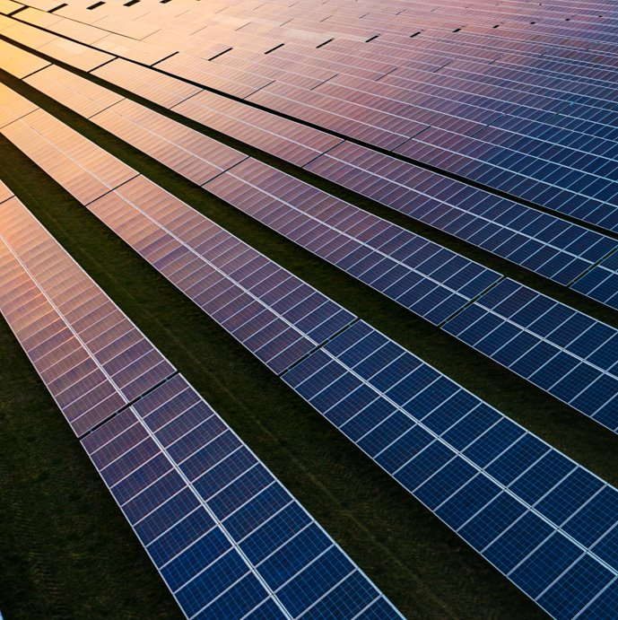
Applications of Product Carbon Footprint
A product carbon footprint allows you to evaluate the GHG emissions impacts of materials and processes and makes it possible to pursue lower-carbon purchasing strategies
Identifying GHG emissions hot spots allows you to develop a carbon reduction roadmap and achievement strategy ​
Prioritize innovation strategies for new technologies and materials
Develop low-carbon materials procurement guidelines (e.g. green steel & aluminum)
Develop supplier engagement plan for decarbonization of raw materials
Support critical suppliers with low-carbon process improvements
Pursue engagement with raw materials industry consortiums
Plan for long-term process improvements and materials circularity
Notes:
A product carbon footprint allows you to evaluate the GHG emissions impacts of materials and processes and makes it possible to pursue lower-carbon purchasing strategies

Slide 39
Key Takeaways
What is a Product carbon footprint? | A product carbon footprint (PCF) is total greenhouse gas (GHG) emissions, or CO2-equivalent emissions (CO2e), generated during the life cycle of a product
What are the steps in conducting a PCF? | Identify the product Identify project partners (LCA consultant) Collect supply chain & manufacturing data Work with project partners to complete the PCF Engage internal & external teams to communicate product benefits and reduce GHG emissions
What are the benefits of having a PCF? | Obtain more accurate and detailed carbon footprints of your product systems Identify emission hot spots Can help identify methods to reduce carbon impacts Helping product differentiation and material level improvements( switch to low carbon materials) Enable comparisons between products fulfilling the same function Use supplier-specific, product-related carbon impacts to quantify accurate impacts Calculate more accurate embodied carbon and scope 3 emissions Develop more detailed plans for scope 3 emissions reduction
Notes:
Finally the key takeaways of today's webinar would be.
What is the product carbon footprint-
We also walk you through the main steps involved in developing a product carbon footprint
The benefits and the applications of the PCFs

Slide 40
Q&A

Slide 41
Thank you for your continued support contact us at gsmsustainability@corning.com
Notes:
Thanks you very much for all for joining us for this webinar series. As we mentioned before we will be sharing the recordings of the webinars with. Please feel free to reach out via the email number if you have any question or clarifications

Slide 42
Product Carbon Footprint
CO₂
1 CO₂ = 1 CO₂
CH₄
Greenhouse Gases
Global Warming
1 CH₄ = 28 CO₂
N₂O
1 N₂O = 265 CO₂
Σ CO₂
equivalents¹

Slide 43
Life Cycle Inventory Part 1: Data Collection
Activity data – | Data that contribute to manufacturing the product
Primary data | Physical data directly attributable to the specific product being investigated Sourced from the commissioner of the study Inputs (e.g., electricity, fuel, paper) Outputs (e.g., products, emissions, wastes) Product manufacturing processes, conversion efficiencies, waste generation Transportation and distribution
Secondary data | Are proxies and assumptions, based on industry average data Life cycle inventory data from reputable sources (e.g., literature, process documents, national labs) Upstream and downstream of the primary process (e.g., power grid mixes, materials production, waste water treatment) Public databases (e.g., ecoinvent, GaBi) Patents, technical chemist descriptions of productions
Data Quality | Temporal coverage, geographical specificity, technology coverage, accuracy, precision, completeness, consistency, reproducibility and data sources

Slide 44
EPD, LCA/PFC and Scope 3 Alignment
A1 – Upstream Production
A2 – Intermediate Transport
A3 – Final Manufacture & Assembly
A4 – Transport to use
A5 –Installation
B1 – B6 – Product Use
C1 – C4 - Product End-of-Life
D1 – Substitution Effects
A1 – Upstream Production
A2 – Intermediate Transport
EPD
Cradle-to-Gate
Grave-to-Cradle
LCA*
Gate-to-Gate
Cradle-to-Grave
Scope 1 & 2 Direct Operations
Scope 3: Category 1. Purchased Goods and Services
GHG Accounting
10. Processing of Sold Products
4&9. Transportation & Distribution
4&9. Transportation & Distribution
11. Use of Sold Products
*Substitution effects should only be considered in raw material extraction or end of life for LCA, but not both
Notes:
Product Carbon Footprints for the Supply Chain Sustainability
Most of the corporate value chain(Scope 3) emissions are associated with products or services upstream and downstream emissions that their manufacturing. Product carbon footprint would help to understand and accurately quantify the scope 3 emission categories such as purchased goods and services, Upstream transportation, Processing of sold products, Use of sold products, and End-of-life treatment of sold products

Slide 45
Key LCA Opportunities
Categories that often benefit from leveraging LCA results
1. Purchased Goods and Services
Tangible and intangible products purchased from all other suppliers not included in other categories
Benefits of LCA
Model specific changes upstream of primary suppliers (e.g. raw material purchases) and process transitions
10. Processing of Sold Products
Customers that purchase products for further processing prior to final sale
Understand impacts of processing of sold products beyond standard energy demand (e.g. cleaning agents; adhesives)
11. Use of Sold Products
Product care (e.g. washing) and operation (e.g. power draw)
Test various use case scenarios; particularly useful for indirect emissions estimates (e.g. washing of durable goods)
12. End of Life Treatment of Sold Products
Disposal method and processing
Assess impacts of end-of-life pathways and understand impacts based on regional purchasing and disposal pathways

